Slide 1
Deggendorf Institute of Technology
HOW 5G CAN BE USED TO PROVIDE/IMPROVE HEALTHCARE SERVICES IN RURAL AREAS
Mubarak Aliyu Danjuma

Slide 2
INTRODUCTION
5G - is the fifth-generation technology standard for broadband cellular networks.
Broadband - is wide bandwidth data transmission which transports multiple signals and traffic types.
Bandwidth - is the difference between the upper and lower frequencies in a continuous band of frequencies. It is typically measured in hertz.

Slide 3
WHY IT CAN BE USED IN RURAL AREA TO IMPROVE HEALTHCARE;
Due to the increased bandwidth, it is expected the networks will not exclusively serve cell phones like existing cellular networks, but also be used as general internet service providers for laptops and desktop computers, competing with existing ISPs such as cable internet, and also will make possible new applications in internet of things (IoT) and machine to machine areas.

Slide 4
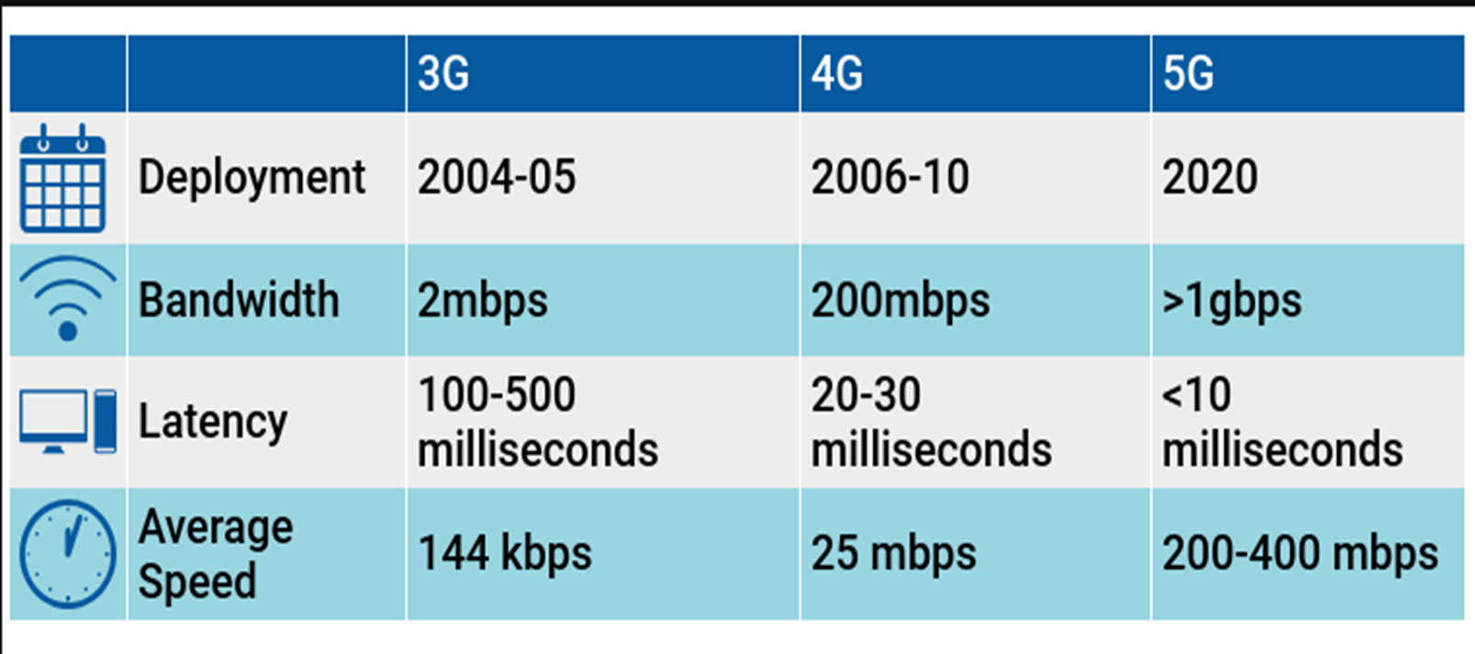
DIFFERENCES WITH OTHER NETWORKS
With 5G technology, which has lower latency and higher capacity, healthcare systems can offer remote monitoring for more patients. Providers can then be confident that they will receive the data they need in real time and can provide the care their patients need and expect.

Slide 5
Our Healthcare Scenarios in rural areas with 5G intervention
Scenario One: Digital- diagnosis of COVID-19 in rural areas,
Scenario Two: Virtual hospital ward/Remote patient monitoring- case of COVID-19,
Scenario Three: Blood sugar monitor.

Slide 6
Scenario One: Digital- diagnosis of COVID-19 in rural areas
The aim of the program: To diagnose covid-19/ care management cases. Highlights: These software works on smart devices (tablets, phones, pcs etc.). The patient is the user, he/she enters personal data, then the software asks about signs, symptoms. Software processing: Calculate the probability for each input, sum it together, store Data, organize and share it with main Hospital/ Medical infection center to ease the treatment, transportation, and admission for any urgent cases. output: If possibility of having covid-19 is high (urgent cases), Emergency testing teams are sent out to the patient, manage and coordinate of health services.
If NOT
(stable ones)
Recommendations, isolation and guidance via video conference by the practitioner.

Slide 7
Start
Input signs, symptoms, and personal data
Calculate the possibility + Data storage and sharing (interoperability with main centers and hospitals)
High
Proba-bility
No
Yes
Recommendations, supplements, isolation and stay healthy via video conference.
organize management and coordination of health services!
End

Slide 8
Scenario Two: Virtual hospital ward/Remote patient monitoring- case of COVID-19
The aim of the program: The patients at high risk of admission to hospital are considered for admission to the ward and for intermediate care management. A virtual ward team is created in specialized health care centers to monitor the patients regularly. In The virtual ward team, patients are discussed at different frequencies depending on their circumstances and stability.
The aim is to reduce the likelihood of admission and the burden on hospitals. Admission to a virtual ward is determined both by predictive modelling and by clinical decision making by the virtual ward team and the patient's doctor.
Patients are being equipped with wearable wireless devices (biosensors) connected to our application, that would automatically and constantly monitor and record their vital signs (blood oxygen saturation, heartbeat rate, temperature, etc.) The patient's room will be equipped with video cameras which are also connected via the app to the virtual ward team in healthcare centers or hospitals.

Slide 9
Software processing: The biosensor wearable device uploads the recorded readings to the application using 5G connection. After every 30minutes the application forwards the readings to the virtual ward team in the health care centres/hospitals using 5G network, making it possible for the “input readings and forwarding” to automatically take place faster and more accurate.
Output: If patients health statistics drops continuously to an intensive care level (Red zone), the app alerts the virtual ward team which in turn sends out an emergency team to the patients designated address. If not, the health professional gives advices and update on new recommendations based on progress (if needed) as feedback through the application’s comment box.

Slide 10
Start
Input
Forward to health care provider every 30mins
Red zone
no
yes
Advice and update on recommendations based on progress
Alerts the health center
End

Slide 11
Scenario Three: Blood sugar monitor
Aim: A program that monitors the blood sugar level of patients by telling them if they are at risk and should immediately link up with their healthcare provider or not. It should be noted that this program works in the form of a chat.
Input: The patient inputs their personal information, and insurance id number, the program saves this info and sends it to the healthcare provider. Then he/she inputs the value of their blood sugar level( if this value is in mg/dl, the program converts this to mmols/L).
Processing: Based on the value input by the patient, the program outputs specific information centered on guiding and helping the patient make the next right step to medication. It should be noted that in the program there are two types of blood sugar level values;
Blood sugar level measured two hours after eating and Blood sugar level measured while fasting.

Slide 12
Output: If the patients’ blood sugar level falls within the normal range, the program notifies the patient.
If the patients’ blood sugar level is too high in any of the above cases ( with respect to their given values), the program advises the patient to immediately take his/her medication( self-injection of insulin or noninsulin medication).
If the patients’ blood sugar level falls within the critical zone( too low or too high), the app goes ahead to notify the patient and ask if he/she would like to link up with a doctor or healthcare provider right away via videoconferencing. This is where the role of 5g comes in. It could therefore the said that 5g would facilitate and speed up the connection of diabetes patients with their healthcare providers in extreme and/or emergency situations.

Slide 13
THANK YOU FOR LISTENING.
Proceed to code explanation of the Scenario three (Blood sugar monitor).

